Slide 1
Memory Management
Swapping
Fragmentation
Paging

Slide 2
Swapping
Swapping is a simple memory or process management method used by the operating system (O.S).
This method is dedicated to increasing the utilization of the processor by moving blocks of data in and out of the main memory.
This data and information are swapped between the main and the secondary memory to optimize memory utilization and increase the processing power.

Slide 3
The process of swapping also forms a queue of temporarily suspended processes as the execution carries out with the newly arrived process.
The concept of swapping consists of two more concepts, swap in and swap out.
Swap Out is the method of removing a process from the RAM and adding it to the Hard Disk.
On the other hand, swap in means, removing the program from the hard disk and placing it back into the main memory or the RAM.

Slide 4
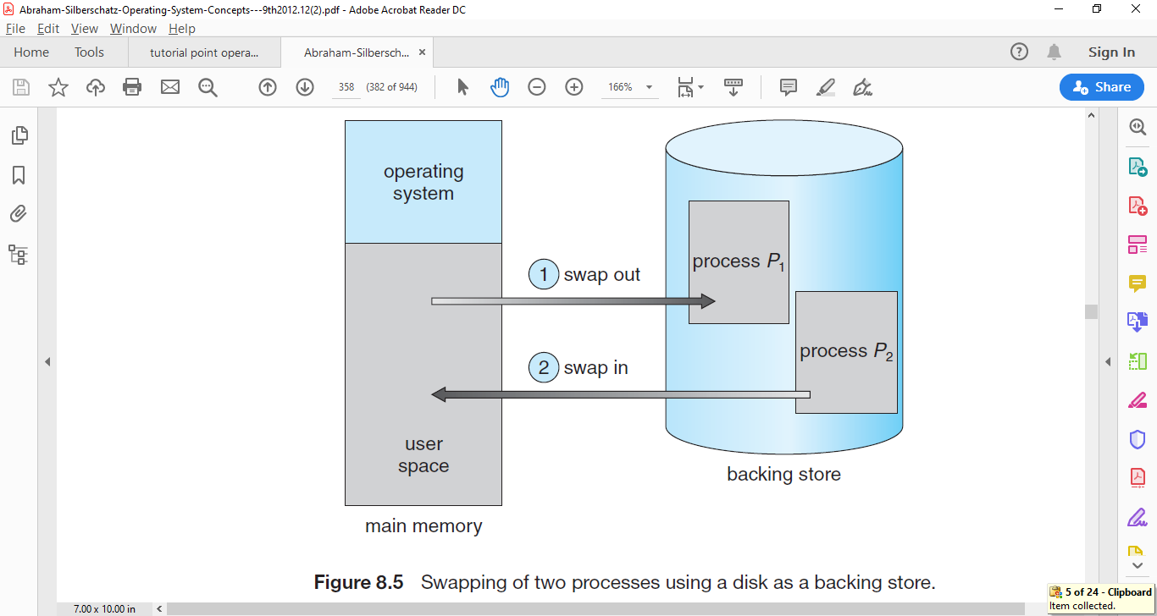
Though performance is usually affected by swapping process but it helps in running multiple and big processes in parallel and that's the reason Swapping is also known as a technique for memory compaction.
Figure X: Swapping of two processes using a disk as a backing store.

Slide 5
Advantages of Swapping
The process helps the CPU to manage multiple processes within the same main memory.
The method helps to create and use Virtual Memory.
The method is economical.
Swapping makes a CPU perform several tasks simultaneously.
Hence, processes do not have to wait for too long before they are executed.

Slide 6
Disadvantages of Swapping
Although the process has no significant or effective disadvantage, the overall method depends heavily on the virtual memory. Such dependability results in a significant performance drop.
In the case of heavy swapping activity, if the computer system loses power, the user might lose all the information related to the program.
If the swapping algorithm is not good, the overall method can increase the number of page faults and decline the overall processing performance.
Inefficiency may arise in the case where a resources or a variable is commonly used by the processes which are participating in the swapping process.

Slide 7
Fragmentation
As processes are loaded and removed from memory, the free memory space is broken into little pieces.
It happens after sometimes that processes cannot be allocated to memory blocks considering their small size and memory blocks remains unused.
This problem is known as Fragmentation.

Slide 8
Memory space in the system constantly goes through loading and releasing processes
and their resources because of which the total memory spaces gets broken into a lot of small pieces,
this causes creation small non utilised fragmented memory spaces, which are so small that normal processes can not fit into those small fragments,
causing those memory spaces not getting utilised at all, this is called memory Fragmentation in operating system.

Slide 9
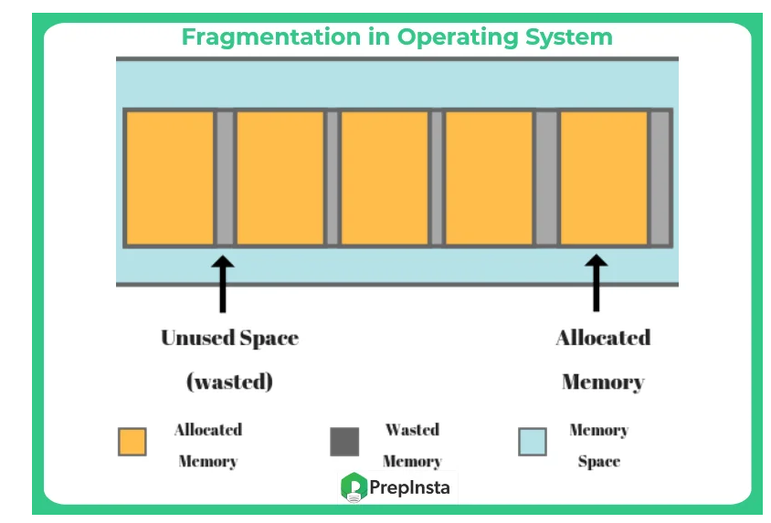

Slide 10
Fragmentation is of the following two types –
Internal Fragmentation
External Fragmentation
Internal Fragmentation
Memory block that is given to the process can comfortably use the block but the size of the block announced,
but it is way bigger than the memory process will require thus causing a that memory remaining unused for further processes.

Slide 11
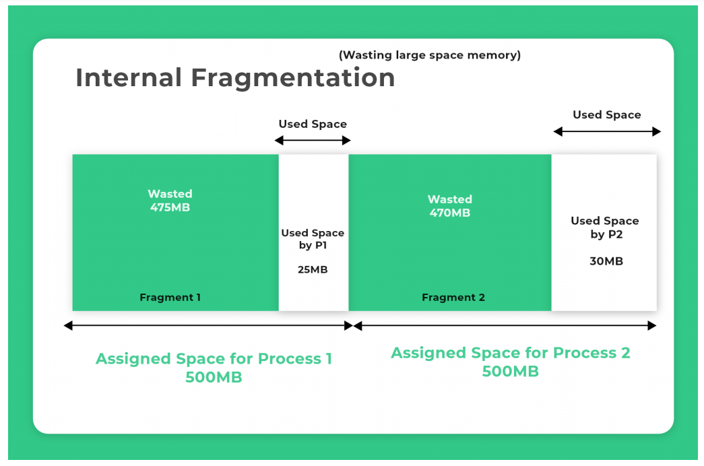

Slide 12
External Fragmentation
The memory space in the system can comfortably satisfy for the processes,
but the available memory space is non-contiguous, thus it further can’t be utilised.
How to solve the fragmentation problem
Re-shuffling the utilised contents of the memory and placing all them together contiguously. Thus compacting the same and free spaces occur together and allocated spaces occur together, this is called compaction for External Fragmentation.
Internal Fragmentation has a few to effectively be reduced by intelligently assigning smaller partitions which though are large enough for the processes.

Slide 13
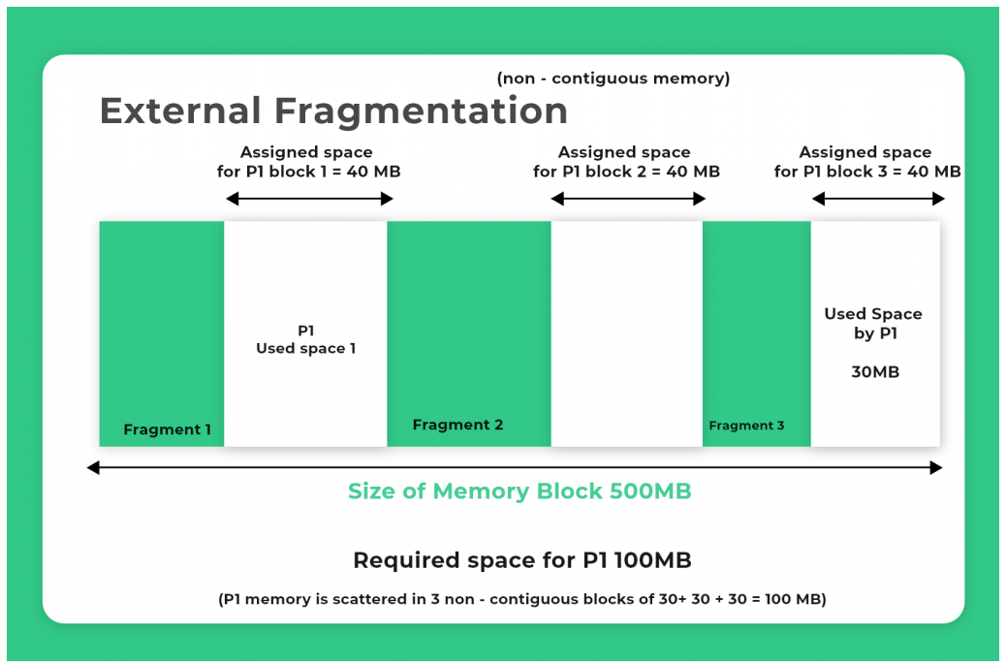

Slide 14
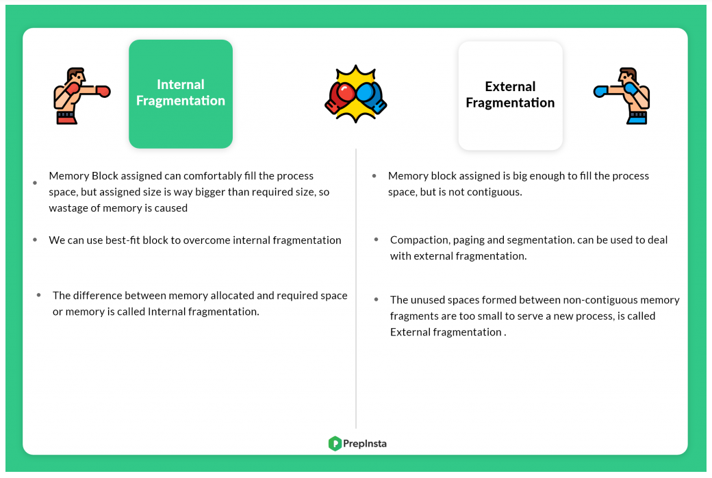

Slide 15
PAGING
Segmentation permits the physical address space of a process to be noncontiguous.
Paging is another memory-management scheme that offers this advantage.
However, paging avoids external fragmentation and the need for compaction, whereas segmentation does not.
It also solves the considerable problem of fitting memory chunks of varying sizes onto the backing store.
Most memory-management schemes used before the introduction of paging suffered from this problem.
The problem arises because, when code fragments or data residing in main memory need to be swapped out, space must be found on the backing store.
The backing store has the same fragmentation problems discussed in connection with main memory, but access is much slower, so compaction is impossible.

Slide 16
A computer can address more memory than the amount physically installed on the system.
This extra memory is actually called virtual memory and it is a section of a hard disk that's set up to emulate the computer's RAM.
Paging technique plays an important role in implementing virtual memory.
Paging is a memory management technique in which process address space is broken into blocks of the same size called pages (size is power of 2, between 512 bytes and 8192 bytes).
The size of the process is measured in the number of pages.
Because of its advantages over earlier methods, paging in its various forms is used in most operating systems, from those for mainframes through those for smart phones.

Slide 17
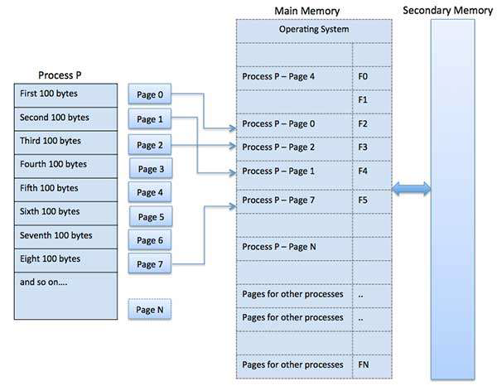
Similarly, main memory is divided into small fixed-sized blocks of (physical) memory called frames and the size of a frame is kept the same as that of a page to have optimum utilization of the main memory and to avoid external fragmentation.

Slide 18
Address Translation
Page address is called logical address and represented by page number and the offset.
Logical Address = Page number + page offset
Frame address is called physical address and represented by a frame number and the offset.
Physical Address = Frame number + page offset
A data structure called page map table is used to keep track of the relation between a pages of a process to frames in physical memory.

Slide 19
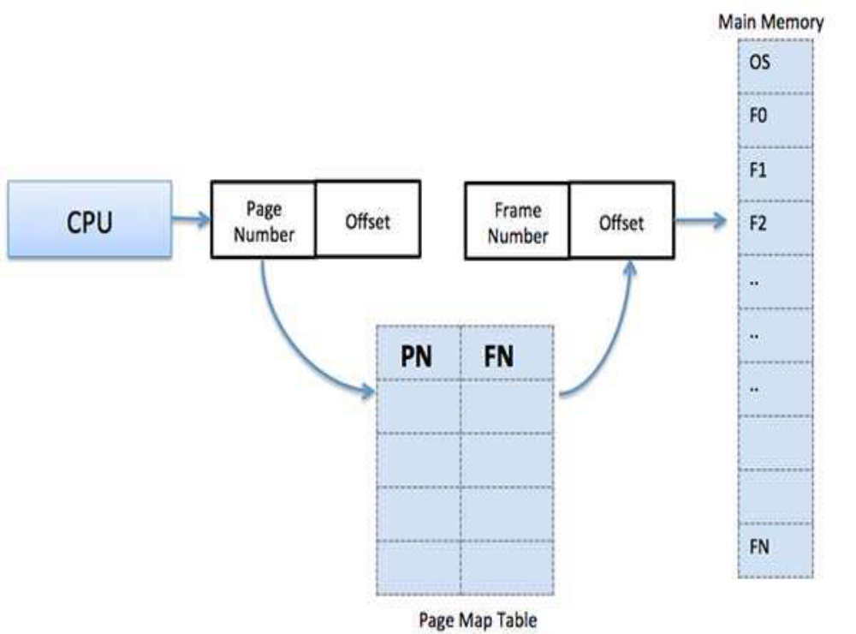

Slide 20
When the system allocates a frame to any page, it translates this logical address into a physical address and create entry into the page table to be used throughout execution of the program.
When a process is to be executed, its corresponding pages are loaded into any available memory frames.
Suppose you have a program of 8Kb but your memory can accommodate only 5Kb at a given point in time,
then the paging concept will come into picture. When a computer runs out of RAM,
the operating system (OS) will move idle or unwanted pages of memory to secondary memory to free up RAM for other processes and brings them back when needed by the program.

Slide 21
The advantages and disadvantages Paging:
Here is a list of advantages and disadvantages of paging:
Paging reduces external fragmentation, but still suffers from internal fragmentation.
Paging is simple to implement and assumed as an efficient memory management technique.
Due to equal size of the pages and frames, swapping becomes very easy.
Page table requires extra memory space, so may not be good for a system having small RAM

